Slide 1

Attributed Network Embedding for Incomplete Structure Information
方子玄
2019/2/26

Slide 2
Introduction
An attributed network enriches a pure network by encoding a part of widely accessible node auxiliary information into node attributes.
Network Embedding (NE) for such an attributed net-work by considering both structure and attribute information has recently attracted considerable attention.

Slide 3
Motivation
Most of previous works have not considered the significant case of a network with incomplete structure information, which however, would often appear in our real-world scenarios e.g. the abnormal users in a social network who intentionally hide their friend-ships.
To tackle that, we propose a robust NE method called Attributed Bi-ased Random Walks (ABRW)to employ attribute information for compensating incomplete structure information by using transition matrices.

Slide 4
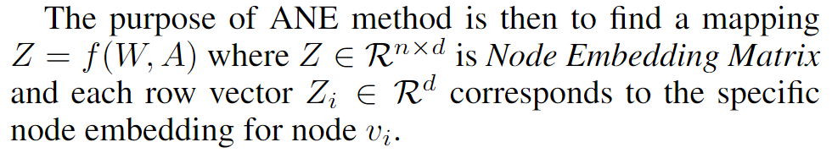
Attributed Biased Random Walks (ABRW)
In this work, we simply use the first order proximity to define W.
In this work, we are not interested in how to preprocess the raw attributes such as users’ profiles and papers’ titles, but instead, assume A is ready-to-use.

Slide 5
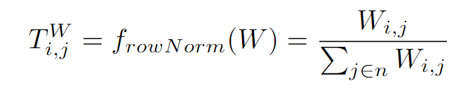
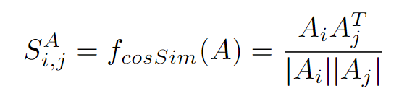
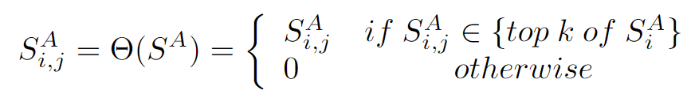
Problem Formulation

Slide 6
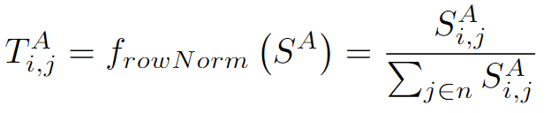
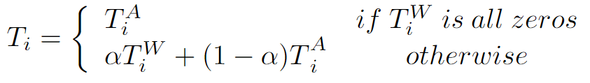

Slide 7
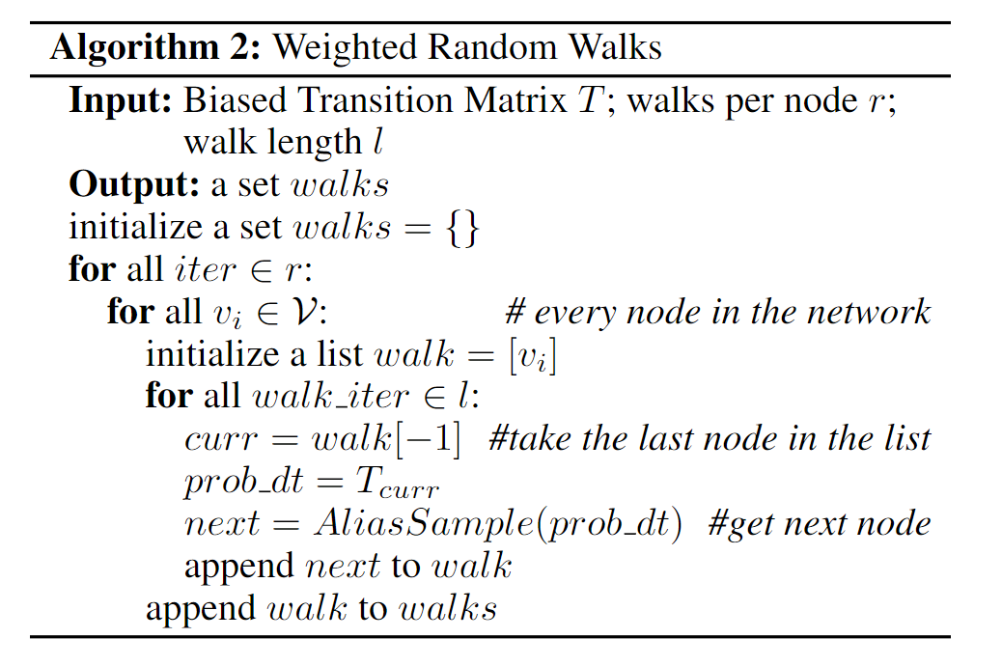
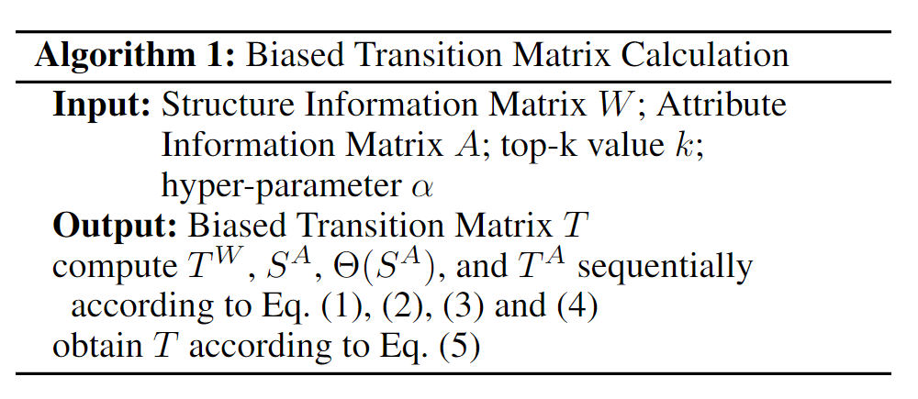
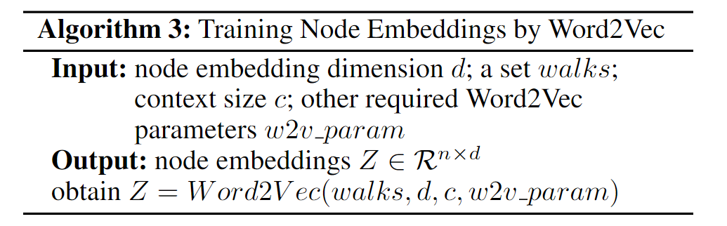

Slide 8
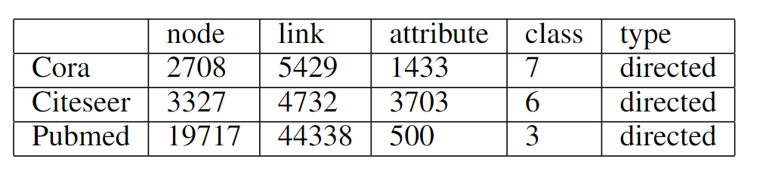
data

Slide 9
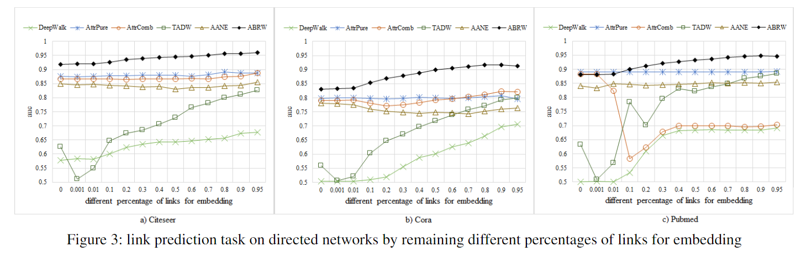
result
our method ABRW consistently outperformances other methods for all cases, and the performances are gradually improving as the avail-able structure information increasing.

Slide 10
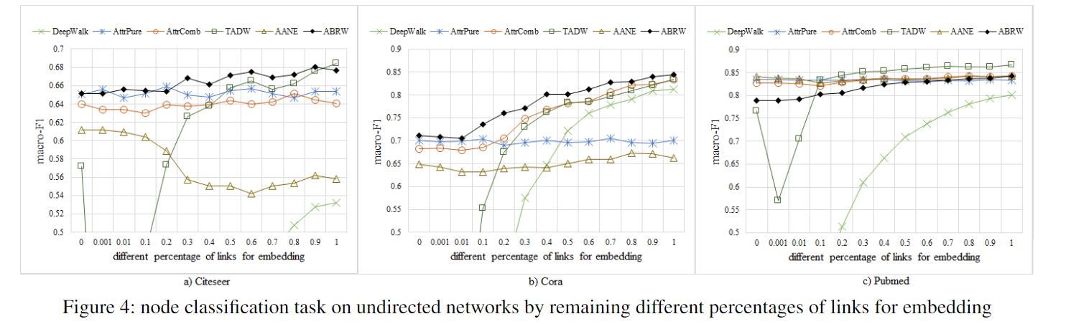
For Citeseer and Cora datasets, ABRW outperformances other methods for almost all cases, which again validates the robustness and effectiveness of our method.
For Pubmed dataset, in case of sufficient links, TADW receives the best performances. However, in case of in-sufficient links, TADW receives very poor performances.

Slide 11
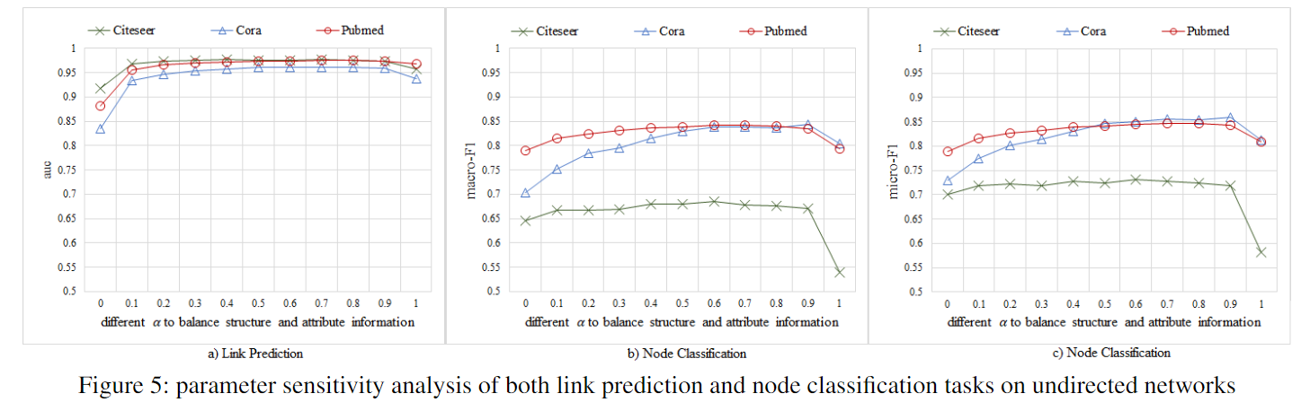

Our method is robust to on both link prediction and node classification tasks, which means it can obtain satisfactory performance without too many tricks on parameter tuning.

Slide 12
Thanks!

